Slide 1
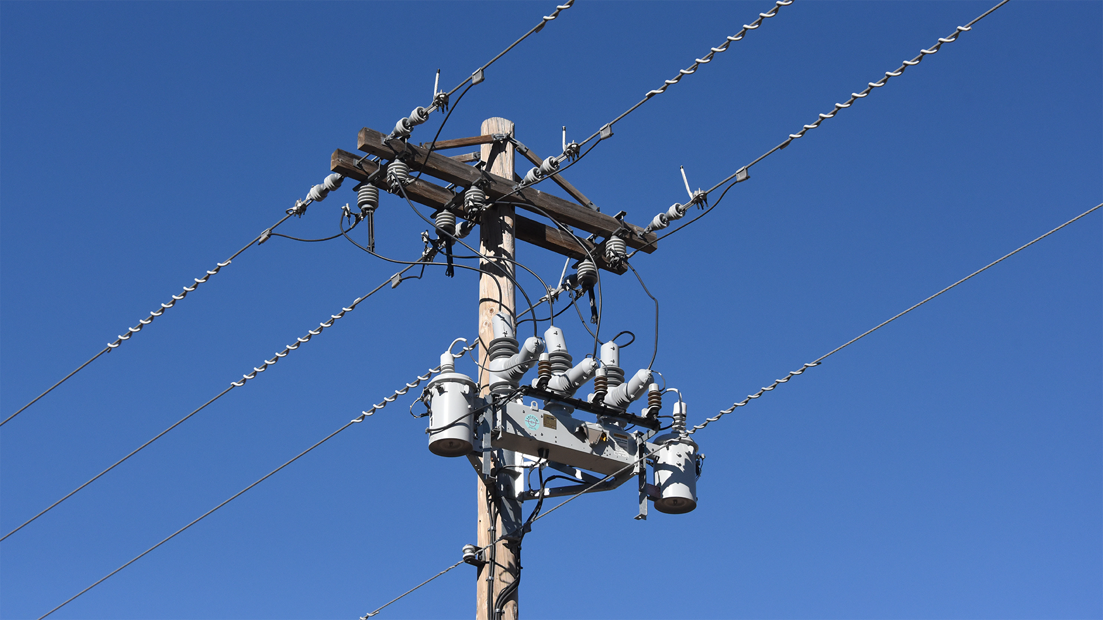
Modeling bidirectional reclosers

Slide 2
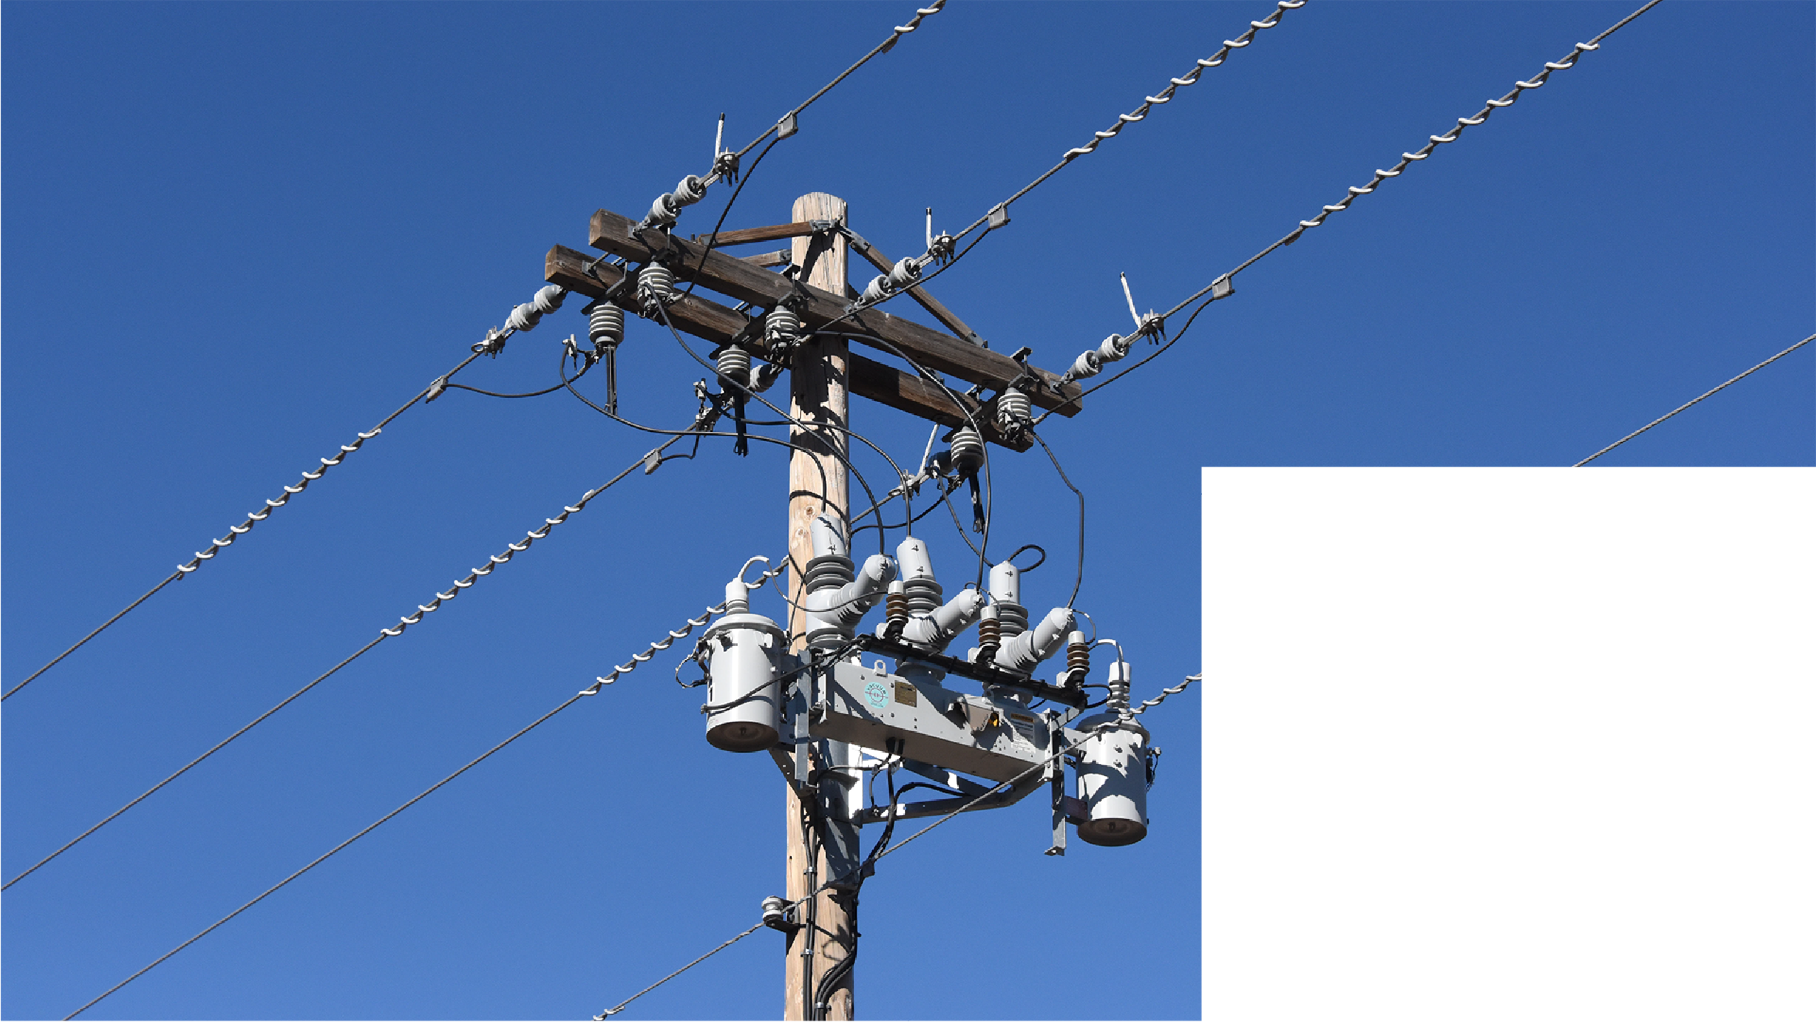

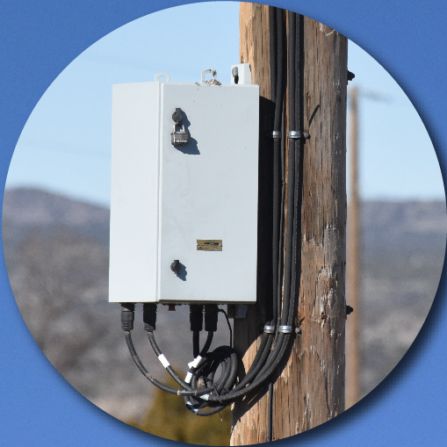
T
ap
Line end
Line end
Arrester
T
ap
Arrester
Reclosers
Transformer
Transformer
Controller

Slide 3
Overhead Bidirectional Three Phase Recloser
Key
Geometric network class or table
Geometric Network Model
Subtype
Primary Overhead Conductor
Three Phase Primary Overhead
Re
DynamicProtectionDevice
Three Phase Electronic Recloser
Po
pole
RECLOSERCONTRO
L
table
Recloser Electonic Control
3 ph overhead line
recloser
3 ph overhead line
RECLOSERUNI
T
table
Re
Recloser Unit
3 recloser units in table
controller unit in table
Po
SupportStructure
W
ood Pole
Relationships in relationship classes:
DynamicProtDev_ReclElecControl
DynamicProtDev_RecloserUnit
SupptStruct_DynamicProtDev

Slide 4
Key
Utility Network feature class
Overhead Bidirectional Three Phase Recloser
Asset Group (subtype)
Asset
T
ype
Utility Network Simple Model
Electric Line
Medium
V
oltage Conductor
Overhead
Three Phase
T
r
Electric Device
Medium
V
oltage
T
ransformer
Overhead Single Phase
Re
Electric Device
Medium
V
oltage Switch
Overhead
Three Phase Recloser
Po
pole
RECLOSERCONTRO
L
table
RECLOSERCONTRO
L
table
Recloser Electonic Control
Recloser Electonic Control
RECLOSERUNI
T
table
RECLOSERUNI
T
table
Recloser Unit
3 ph overhead line
recloser
3 ph overhead line
Recloser Unit
Re
3 recloser units in table
Structure Point
controller unit in table
Po
Medium
V
oltage Pole
Single Pole
Relationships in relationship classes:
DynamicProtDev_ReclElecControl
DynamicProtDev_RecloserUnit
SupptStruct_DynamicProtDev

Slide 5
Key
Utility Network feature class
Overhead Bidirectional Three Phase Recloser
Asset Group (subtype)
Asset
T
ype
Utility Network Detailed Model
Electric Line
Medium
V
oltage Conductor
Po
pole
Overhead
Three Phase
T
r
Electric Device
Medium
V
oltage
T
ransformer
Overhead Single Phase
Re
Electric Device
R
A
Medium
V
oltage Switch
Overhead One Phase Recloser
recloser assembly
Ct
Electric Device
line
LE
LE
line
Medium
V
oltage Controller
end
end
Recloser
Ar
Electric Device
phase
A
Medium
V
oltage
Arrester
T
Line
a
Ar
Ar
T
tap
Re
a
tap
1ph arrester
1ph recloser
1ph arrester
T
Electric Junction
a
Connection Point
T
r
Ct
T
r
Overhead
T
1ph transformer
ap
controller
1ph transformer
Electric Junction
phase B
LE
Medium
V
oltage Line End
T
a
Ar
Re
Ar
T
tap
a
tap
Overhead Line End
1ph arrester
1ph recloser
1ph arrester
Po
Structure Point
overhead
overhead
Medium
V
oltage Pole
3ph line
phase C
3ph line
Single Pole
T
a
Ar
Re
Ar
T
tap
a
tap
Electric
Assembly
1ph arrester
1ph recloser
1ph arrester
R
A
Medium
V
oltage Switch Bank
Overhead
Three Phase Recloser
Containment association
Connectivity association
Structural attachment association

